Slide 1
Fast Gradient Sign Method (FGSM) Adversarial Attack Against Intrusion Detection System
cyBER 207 Applied Machine Learning for Cybersecurity
Professor Nahid ghalaty
By Gregory David Mamoyac
Notes:
My name is Greg Mamoyac and my research was on FGSM adversarial attack against an Intrustion Detection System

Slide 2
Problem Statement
The problem statement is to evaluate the vulnerability of a neural network based intrusion detection system through Fast Gradient Sign Method (FGSM) adversarial attacks.
The hypothesis is that the FGSM attack will be successful for evading detection against the intrusion detection system and cause failure of the victim model through small perturbations.
Notes:
My goal here was to Evaluate the vulnerability of a neural network based intrusion detection system pitted against Fast Gradient Sign Method (FGSM) adversarial attacks.
I hypothesize that FGSM attack will be successful for evading detection against the intrusion detection systems through small perturbations of input data.

Slide 3
Neural Network Victim Model
The Training, Testing, and Evaluation methods of the Feedforward Neural Network will be used as the IDS victim of FGSM adversarial attack.
Notes:
The following slides will be the Training, Testing, and Evaluation methods of the Feedforward Neural Network. This will be used as the Intrusion detection system and the victim of FGSM adversarial attack.

Slide 4
Specifications
Kaggle’s Cybersecurity Intrusion Detection Dataset
https://www.kaggle.com/datasets/dnkumars/cybersecurity-intrusion-detection-dataset/data
Size 725.13 KB
Useful for supervised machine learning, where a model learns from labeled attack patterns.
Libraries
Pandas
Numpy
Torch
Sklearn
Matplotlib
Notes:
I used Kaggle’s Cybersecurity Intrusion Detection Dataset
https://www.kaggle.com/datasets/dnkumars/cybersecurity-intrusion-detection-dataset/data
Size 725.13 KB
Which is useful for supervised machine learning
I also used python Libraries to include
Pandas
Numpy
Torch
Sklearn
Matplotlib

Slide 5
Cybersecurity Intrusion Detection Dataset
Target Variable
(attack_detected)
Binary classification: 1 means an attack was detected, 0 means normal activity
Notes:
In the dataset the Target Variable was attack_detected that used Binary classification where 1 means an attack was detected, 0 means normal activity

Slide 6
Cybersecurity Intrusion Detection Dataset
Network Based Features
network_packet_size (Packet Size in Bytes)
protocol_type (Communication Protocol)
encryption_used (Encryption Protocol)
Notes:
The following network based features were:
network_packet_size (Packet Size in Bytes)
Size ranging between 64 to 1500 bytes.
Important because Attackers may use abnormally small or large packets for reconnaissance or exploitation attempts.
protocol_type (Communication Protocol)
The protocol used in the session: TCP, UDP, or ICMP - often use in DoS attacks.
encryption_used (Encryption Protocol)
Values: AES, DES, None.

Slide 7
Cybersecurity Intrusion Detection Dataset
User Behavior Based Features
login_attempts (Number of Logins)
session_duration (Session Length in Seconds)
failed_logins (Failed Login Attempts)
unusual_time_access (Login Time Anomaly)
ip_reputation_score (Trustworthiness of IP Address)
browser_type (User’s Browser)
Notes:
User behavior features included
(Number of Logins)
(Session Length in Seconds)
(Failed Login Attempts)
(Login Time Anomaly)
(Trustworthiness of IP Address)
(User’s Browser)

Slide 8
Methods to Load and Process Train and Test Dataset with Feature Engineering
Train Dataset
Test Dataset
The processed dataset is split into training and validation, allocating 80% to train and 20% to validate.
The model is trained on and validated on during the 10 epochs.
This ensures the validation set is separate from the training data used to fit the model.
Data normalization is applied to both Train and Test Datasets by scaling inputs and preventing any feature from dominating
The model also creates a new test set that is distinct from the initial code used for validation.
The Feature Engineering is applied to both Datasets and focuses on login_attempt_rate, login_attempts, session_duration, failed_login_ratio, and failed_logins
Notes:
These are the methods to load and process the NN Victim Model.
The processed dataset was using 80/20 split to validate and train via 10 epochs to limit overfitting.
Data normalization was applied to both Train and Test Datasets by scaling inputs and preventing any feature from dominating
The Feature Engineering focuses on login_attempt_rate, login_attempts, session_duration, failed_login_ratio,and failed_logins
These features were improved the model because:
High login attempts indicate brute-force attacks and high failed attempts indicate credential stuffing or dictionary attacks.
Typical users have 1–3 login attempts, and many failed attempts followed by a successful login could suggest an account was compromised.
Very long sessions might indicate unauthorized access or persistence by an attacker.

Slide 9
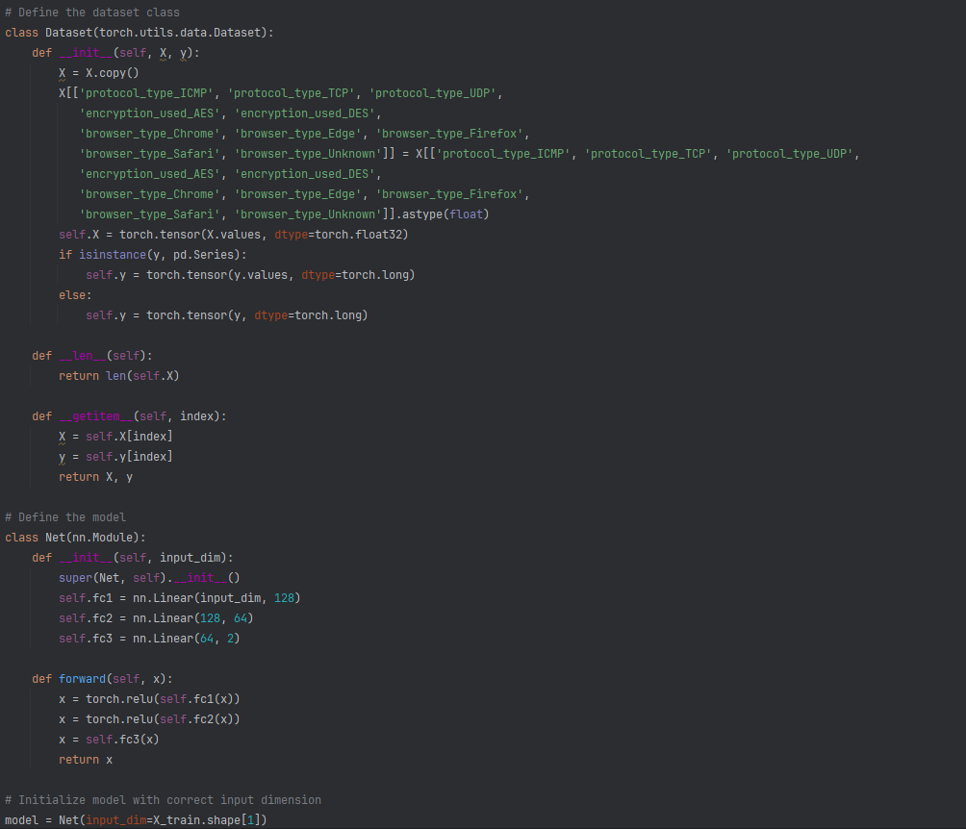
Define the Intrusion Detection Model
Feedforward neural network using PyTorch for binary classification.
Model layers are designed to map an input feature vector to a two-dimensional output representing class probabilities.
Trained using cross-entropy loss and the Adam optimizer
The basic multi-layer perceptron learns to classify data into one of two categories based on the input features.
Notes:
Model definition is a simple feedforward neural network using PyTorch for binary classification.
The model consists of three fully connected layers with ReLU activation functions, designed to map an input vector to a two-dimensional output of class probabilities. This supports limited model capacity and prevents over complexity with 128 and 64 neurons.
It was trained using cross-entropy loss and an Adam optimizer, which is a basic multi-layer program that learns to classify data into categories based on the input features.

Slide 10
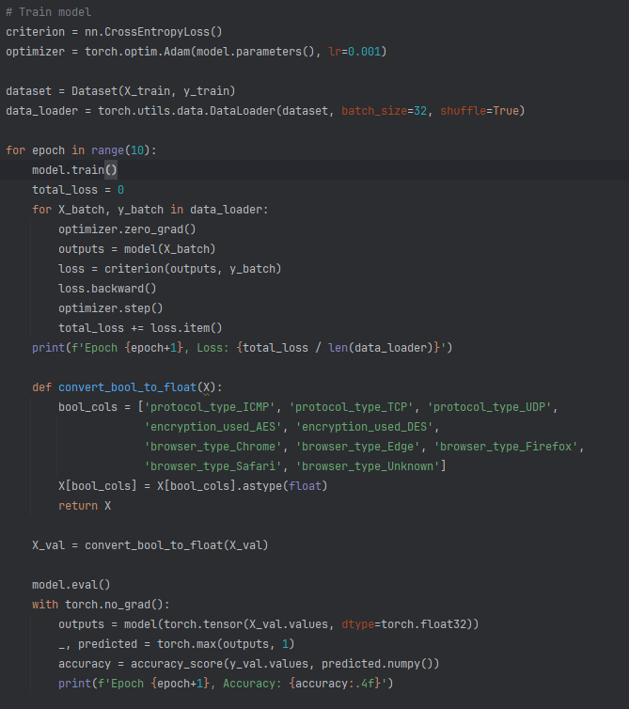
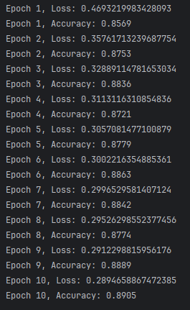
Train the Intrusion Detection Model
Training with Adam optimizer and cross-entropy loss over 10 epochs
Evaluate its performance on a validation set after each epoch.
The training loop iterates through batches of the training data, calculates the loss, performs backpropagation, and updates the model's weights.
The evaluation step computes the accuracy on the validation set to monitor the model's learning progress
Notes:
Model training evaluates the performance on a validation set after each epoch.
The training loop iterates through batches of the training data, calculates the loss, performs backpropagation, and updates the model's weights, while the evaluation step computes the accuracy to monitor the model's learning.
Its important to note that mini-batch size of 32 adds noise to training updates, aiding generalization
The output shows the model improving accuracy over 10 epochs, with loss dropping from 0.85 to 0.89.

Slide 11
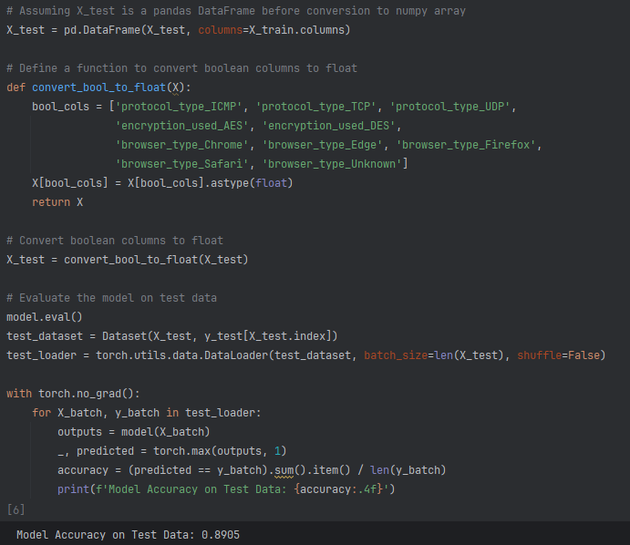
Evaluate the Intrusion Detection Model on Test Data
The evaluation is performed by setting the model to evaluation mode and loading the test data into a single batch using DataLoader.
With PyTorch, the model generates predictions from X_batch, and torch.max determines the predicted class labels.
The accuracy is calculated by comparing these predictions to the true , computing the proportion of correct predictions.
Accuracy = 0.8905
Notes:
Evaluation is performed by setting the evaluation function and loading the test data into a batch using DataLoader.
The model generates predictions from the input data with PyTorch and uses torch.max to determine the predicted class labels.
The accuracy calculates by comparing these predictions to the true records and computes the proportion of correct predictions.
The final accuracy = 0.8905 showing strong ability of the IDS model to distinguish between classes.

Slide 12
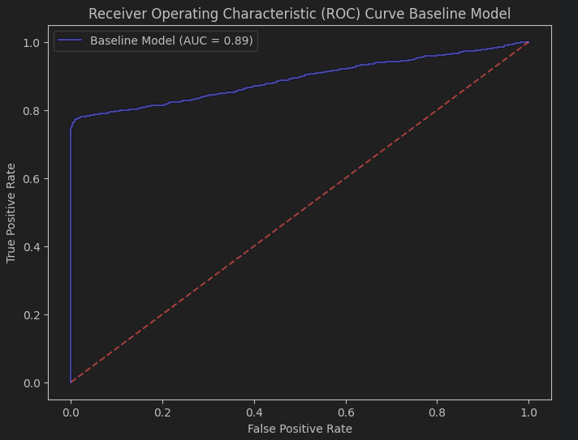
Error Analysis - Neural Network Victim Model
Notes:
The ROC curve shows the relationship between the True Positive rate and the False Positive rate.
Area Under the Curve is 0.89, which indicates that the model has good performance can correctly detect potential attacks or intrusions on the victim system.

Slide 13
FGSM Attack Model
Fast Gradient Sign Method (FGSM) is an adversarial attack technique used in machine learning to generate adversarial examples by introducing small, controlled perturbations to input data, causing misclassification by models like neural network.
Notes:
With the Intrusion Detection System in place, we can now programmatically apply FGSM
Fast Gradient Sign Method (FGSM) is an adversarial attack to generate adversarial examples through small, controlled perturbations of the input data, causing misclassification by models like neural network.

Slide 14
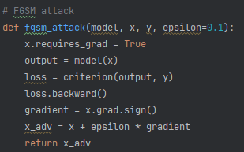
Define the FGSM Attack Model
Input data x is set up so that program can track how changes will affect the model
Loss function makes predictions on x and compares this to y
Backpropagation allows the program to figure out which direction it needs change x in order to increase the loss for the attack.
Perturbations are created by multiplying that sign of the loss gradient and multiplying it by small numbers called epsilon to subtly alter input to the victim model
Notes:
To Define the FGSM Attack Model is simple.
Input data x is set up so that adversary program can track how changes will affect the model and the loss function makes predictions on x and compares to y.
Backpropagation allows the program to figure out which direction it needs change x in order to increase the loss for the attack.
The changes in x are called perturbations. These are multiplied to the sign of the loss gradient and also multiplied by small numbers called epsilon which subtly alter input to the victim model.

Slide 15
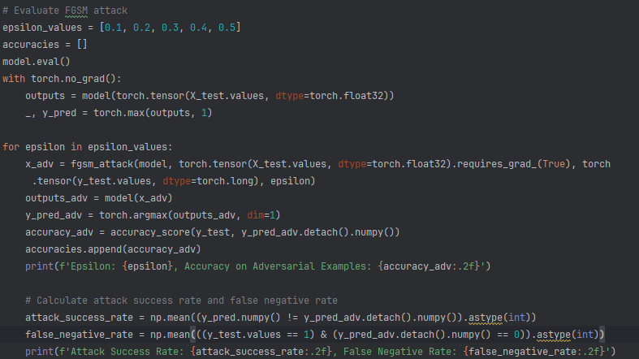
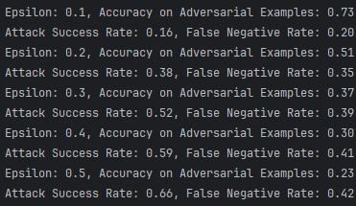
Evaluate the FGSM Attack Model
Evaluation tries multiple values of epsilon from 0.1 to 0.5
The program predicts labels as a baseline and then uses fgsm_attack to create small adversarial examples to confuse the model
The damage is measured by checking the accuracy and the attack success rate
The results show that increasing epsilon also increases the Attack Success Rate and False Negative Rate while Accuracy Decreases
Notes:
Evaluation tries multiple values of epsilon from 0.1 to 0.5
The adversary program predicts labels as a baseline and then uses fgsm_attack to create small adversarial examples
This confuses the victim model and the damage is measured by checking the accuracy and the attack success rate
The results show that increasing epsilon also increases the Attack Success Rate and False Negative with rates increasing from 0.16 and 0.20 to 0.66 and 0.42 respectively

Slide 16
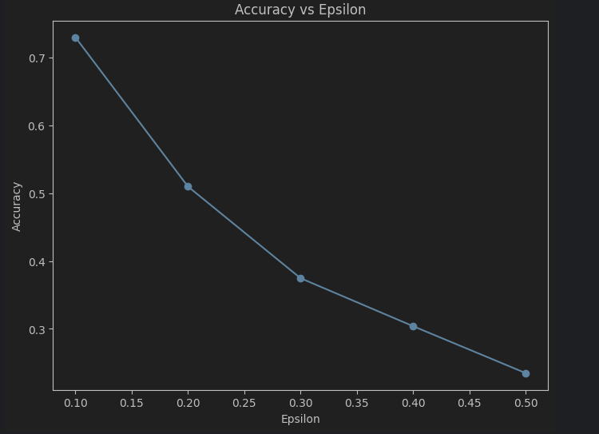
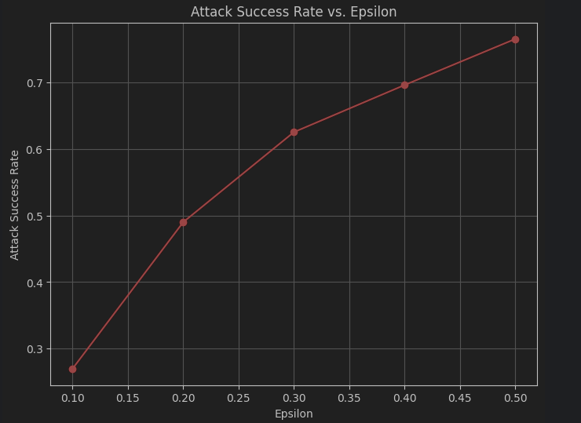
Error Analysis – FGSM Attack Model
Notes:
Here, increasing the epsilon value of the Attack model leads to a decrease in accuracy of the IDS Victim Model.
In contrast, the Attack Success Rate shows the attack model’s accuracy. We expect the Attack Success Rate to increase as Epsilon value increases for a successful attack.

Slide 17
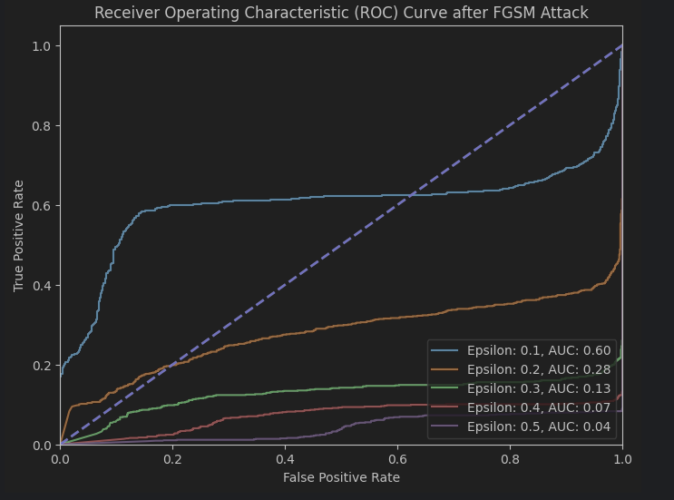
Error Analysis – FGSM Attack Model
Notes:
The ROC Curve also suggests that as the epsilon value increases, the model's performance decreases.
The area under the curve decreases as the epsilon values increases, this shows the Victims declining performance to distinguish between true classifications.
The Purple Line for 0.5 Epsilon suggests that the FGSM attack has significantly compromised the model's performance and so the IDS victim performs worse than random guessing.
The attack model can generate adversarial examples that are able to fool the model, resulting in a successful attack and major inaccuracy of the victim neural network.

Slide 18
Mitigations Techniques
These are the most effective techniques to mitigate FGSM Attack
Adversarial Training (Most Effective)
Why: Trains the model on both clean and FGSM-generated examples, directly improving robustness.
Pros: Proven to significantly increase resistance to FGSM and related attacks.
Input Preprocessing (Feature Squeezing, JPEG Compression)
Why: Disrupts small perturbations before the model processes them.
Pros: Easy to implement; works as a plug-in step.
Robust Architectures with Regularization
Why: Some models and training regimes are naturally more robust (dropout, weight decay, or robust loss functions).
Pros: Improves general robustness and can reduce overfitting.
Notes:
Mitigating the Fast Gradient Sign Method (FGSM) and similar adversarial attacks involves techniques that improve a model’s robustness against malicious perturbations. These the top 3 most effective techniques to this attack.
Adversarial Training is the Most Effective because it trains the model on both clean and FGSM-generated examples, directly improving robustness.
Input Preprocessing includes Feature Squeezing, JPEG Compression disrupts any small perturbations before the model processes them and it is easy to implement.
Finally, using more Robust Architectures and training regimes that include regularization can reduce overfitting and the mitigate the effects of perturbations in an FGSM attack

Slide 19
References
[1] A. Ng, "Deep Learning Specialization," Coursera, 2017. [Online]. Available: https://www.coursera.org/specializations/deep-learning
[2] PyTorch, "Learning PyTorch with Examples," PyTorch Tutorials, 2023. [Online]. Available: https://pytorch.org/tutorials/beginner/blitz/neural_networks_tutorial.html
[3] TensorFlow, "Keras Sequential API," TensorFlow Guide, 2023. [Online]. Available: https://www.tensorflow.org/guide/keras/sequential_model
[4] I. J. Goodfellow, J. Shlens, and C. Szegedy, "Explaining and Harnessing Adversarial Examples," arXiv preprint arXiv:1412.6572, 2014. [Online]. Available: https://arxiv.org/abs/1412.6572
[5] PyTorch, "Adversarial Example Generation," PyTorch Tutorials, 2023. [Online]. Available: https://pytorch.org/tutorials/beginner/fgsm_tutorial.html
[6] TensorFlow, "Adversarial Examples using FGSM," TensorFlow Tutorials, 2023. [Online]. Available: https://www.tensorflow.org/tutorials/generative/adversarial_fgsm
[7] N. Papernot et al., "CleverHans: An adversarial example library for constructing attacks and defenses," GitHub Repository, 2017. [Online]. Available: https://github.com/cleverhans-lab/cleverhans
[8] A. Madry, A. Makelov, L. Schmidt, D. Tsipras, and A. Vladu, "Towards Deep Learning Models Resistant to Adversarial Attacks," arXiv preprint arXiv:1706.06083, 2018. [Online]. Available: https://arxiv.org/abs/1706.06083
[9] N. Papernot, P. McDaniel, X. Wu, S. Jha, and A. Swami, "Distillation as a Defense to Adversarial Perturbations Against Deep Neural Networks," arXiv preprint arXiv:1511.04508, 2016. [Online]. Available: https://arxiv.org/abs/1511.04508
[10] W. Xu, D. Evans, and Y. Qi, "Feature Squeezing: Detecting Adversarial Examples in Deep Neural Networks," arXiv preprint arXiv:1704.01155, 2017. [Online]. Available: https://arxiv.org/abs/1704.01155
[11] IBM, "Adversarial Robustness Toolbox (ART)," Trusted AI GitHub Repository, 2023. [Online]. Available: https://github.com/Trusted-AI/adversarial-robustness-toolbox

